Slide 1

CS544 Project: Property Analysis with R
Krishanu Ghosh

Slide 2
Presentation Outline
Dataset Acquisition
Pre-processing / Cleansing
Data Analysis
Categorical Data
Numerical Data
Bivariate
Sampling and Central Limit Theorem
Various Sampling
Data Analysis with summarized Data

Slide 3
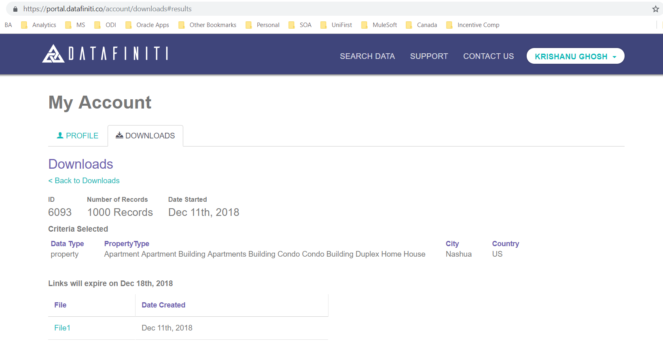
Dataset Acquisition
Dataset chosen is free sample of property data downloaded from DATAFINITY, a popular DaaS (Data as a service) platform. I have selected 1000 rows property data of around Nashua, NH freely available.

Slide 4
Dataset Acquisition (Contd)
Data acquired is in JSON format and contains lots of noises and outliers.
Data is first read into a R Dataframe
Nested JSON list elements are flattened and fit into the Tabular data. Information's obtained by looking into the nested JSON elements are – Price, Price per Square Foot, Property Tax.
School information was in form of List with mix of Elementary, Middle and High school names in one list. This is extracted by going deep into list and extracting the names of nearest Elementary, Middle and High school names.

Slide 5
Data Cleansing \ Pre-processing
Data loaded into R Dataframe is analyzed and cleansed
Floor size has 6 outlier rows where Floor size of a 2 BR house is mentioned as couple of Millions of square foot – replaced with Mean
Two Prices found as (1000 times) than normal value – 3 zeros at end trimmed
9 Postal code had zip plus four. Smoothened it to Zip.
Removed rows with NULL Postal Code as they are bad addresses and wrong prices
Removed rows with NULL prices
Removed 9 rows with NULL province
Removed 1 row with province = IA as Iowa also has a city of City Nashua

Slide 6
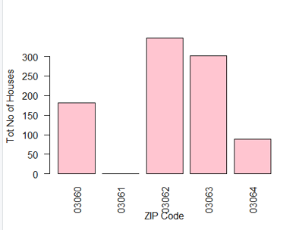
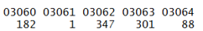
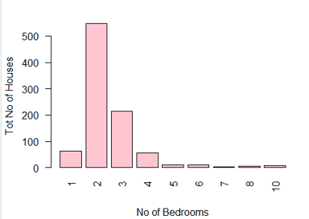
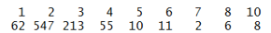
Data Analysis – Categorical Data
No of properties available by Zip Code
No of properties available by Total No of Bed rooms

Slide 7
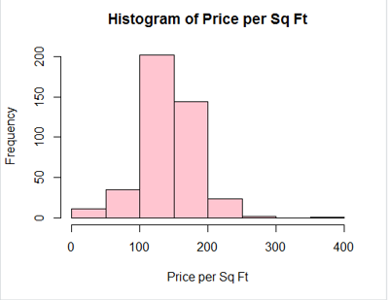
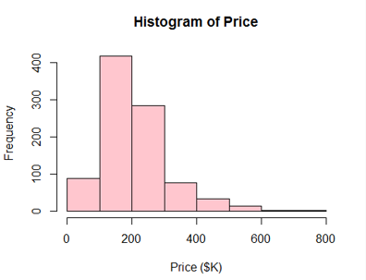
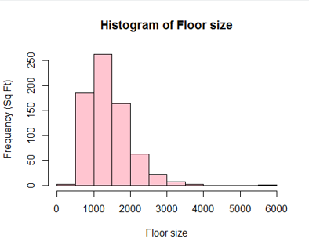
Data Analysis – Numerical Data
Price per Sq Ft
Price
Floor size

Slide 8
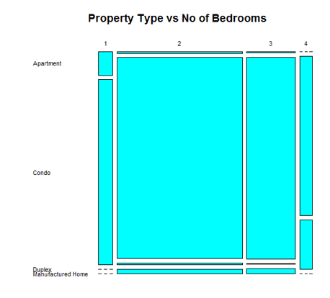
Data Analysis – Bivariate Data
Property Type Vs No of Bedroom

Slide 9
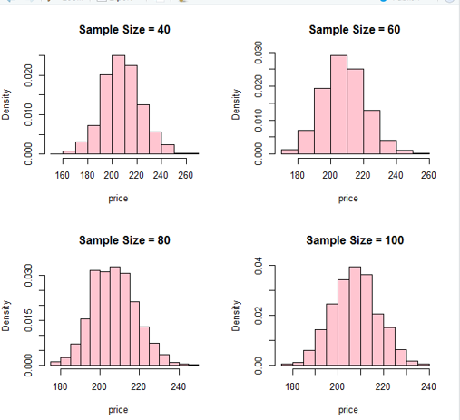
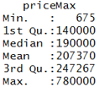
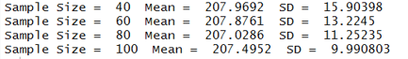
Sampling Analysis – Central Limit Theorem
Price original Data
Price with sample size

Slide 10
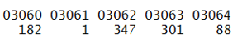
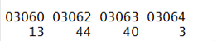
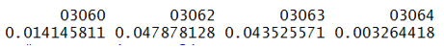
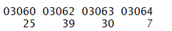
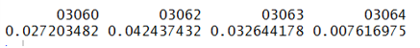
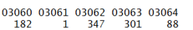
Various Sampling
Data Distribution
SRSWOR
Systematic
Stratified

Slide 11
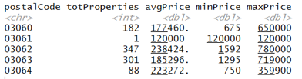
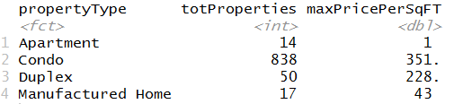
Additional Data Analysis with Tibble
Show summary of Properties and prices by Zip code
Summary of properties by Type

